Slide 1

PRESENTED BY:
DAP – GROUP 1

Slide 2
MTN CUSTOMER INSIGHTS DASHBOARD-1ST QUARTER 2025
Background
This analysis explores customer purchase behavior, data usage, and revenue patterns across different demographics and plan types. The goal is to uncover key trends that can drive customer retention, satisfaction, and profitability.
Objectives
Analyze monthly data usage and revenue performance.
Identify high-value customers and churn patterns.
Examine how age, device, and plan type influence revenue.
Provide recommendations to enhance customer experience.

Slide 3
DATA FIELDS
KPIs
Customer Information
Customer ID
Age
Gender
State
Subscription & Usage
MTN Device / Device Category
Subscription Plan / Plan Type Category
Data Usage
Data Usage Per Month
Financial Metrics
Total Revenue
Revenue Per Month
Customer Experience & Retention
Satisfaction Rate
Customer Review
Customer Churn Status
Reasons for Churn
High Value Customer
TOTAL NUMBER OF CUSTOMERS - 496 (MALE - 246, FEMALE - 250)
TOTAL REVENUE - 199,348,200
TOTAL NUMBER OF ORDERS- 10,290
%CHURNED CUSTOMERS - 29
%ACTIVE CUSTOMERS - 71
AGE GROUP - [Adult = <24, Youth = <40, Mid-Age = <60, Senior = >60]
DEVICE CATEGORY - Router, Mobile SIM, MiFi
PLAN TYPE CATEGORY - Monthly, Daily, Others(Yearly)
UNITS FOR DATA ANALYSIS- Gigabyte

Slide 4
NUMBER OF CUSTOMERS ACROSS THE STATES
STATE | CUSTOMER COUNT
Osun | 20
Kogi | 20
Bauchi | 20
Abia | 18
Borno | 18
Yobe | 17
Abuja (FCT) | 17
Enugu | 17
Oyo | 17
Gombe | 16
Benue | 16
Imo | 16
STATE | CUSTOMER COUNT
Ekiti | 16
Edo | 16
Katsina | 16
Zamfara | 15
Anambra | 15
Nasarawa | 15
Sokoto | 14
Cross River | 14
Kebbi | 14
Taraba | 13
Plateau | 13
Jigawa | 13
STATE | CUSTOMER COUNT
Niger | 12
Adamawa | 11
Kwara | 11
Akwa Ibom | 10
Kano | 10
Bayelsa | 10
Delta | 10
Rivers | 10
Ondo | 9
Lagos | 9
Kaduna | 8

Slide 5
AVERAGE USAGE AND REVENUE BY PLAN TYPE CATEGORY, AND DEVICE CATEGORY.
TOTAL REVENUE BY PLAN TYPE, CATEGORY, AND DEVICE CATEGORY
Plan Type category | Device Category | Avg. Data Usage | Avg Data Per Month | Avg Revenue Per Month
Daily | Mobile SIM | 102.74 | 6.35 | 231.55
Monthly | MIFI | 103.46 | 6.63 | 12998.30
Monthly | Mobile SIM | 103.06 | 6.59 | 5693.60
Monthly | Router | 95.55 | 6.57 | 15300.01
Other | Mobile SIM | 97.93 | 5.69 | 574.66
Other | Router | 97.38 | 8.98 | 77651.00
Plan Type Category | Device Category | Total Revenue
Monthly | Router | 79,271,000
Other | Router | 58,575,000
Monthly | MiFi | 48,067,500
Monthly | Mobile SIM | 12,357,500
Other | Mobile SIM | 848,000
Daily | Mobile SIM | 229,200

Slide 6
TOTAL NUMBER OF ORDERS BASED ON PLAN TYPE AND CATEGORY
Plan Type Category | Device Category | Number of Orders
Monthly | Router | 4158
 | MiFi | 2556
 | Mobile SIM | 1513
Other | Mobile SIM | 995
Daily | Mobile SIM | 555
Other | Router | 513

Slide 7
TOTAL NUMBER OF ORDERS/TOTAL REVENUE BY SUBSCRIPTION PLAN(TOP 10)
 | Total_number_of_orders | Total_Revenue
Subscription Plan
150GB FUP Monthly Unlimited | 949 | 18,980,000
60GB Monthly Broadband Plan | 909 | 13,180,500
30GB Monthly Broadband Plan | 880 | 7,920,000
300GB FUP Monthly Unlimited | 859 | 25,770,000
165GB Monthly Plan | 750 | 26,250,000
120GB Monthly Broadband Plan | 665 | 15,960,000
10GB+10mins Monthly Plan | 622 | 2,799,000
65GB Monthly Plan | 582 | 9,312,000
25GB Monthly Plan | 480 | 4,320,000
12.5GB Monthly Plan | 406 | 2,233,000

Slide 8
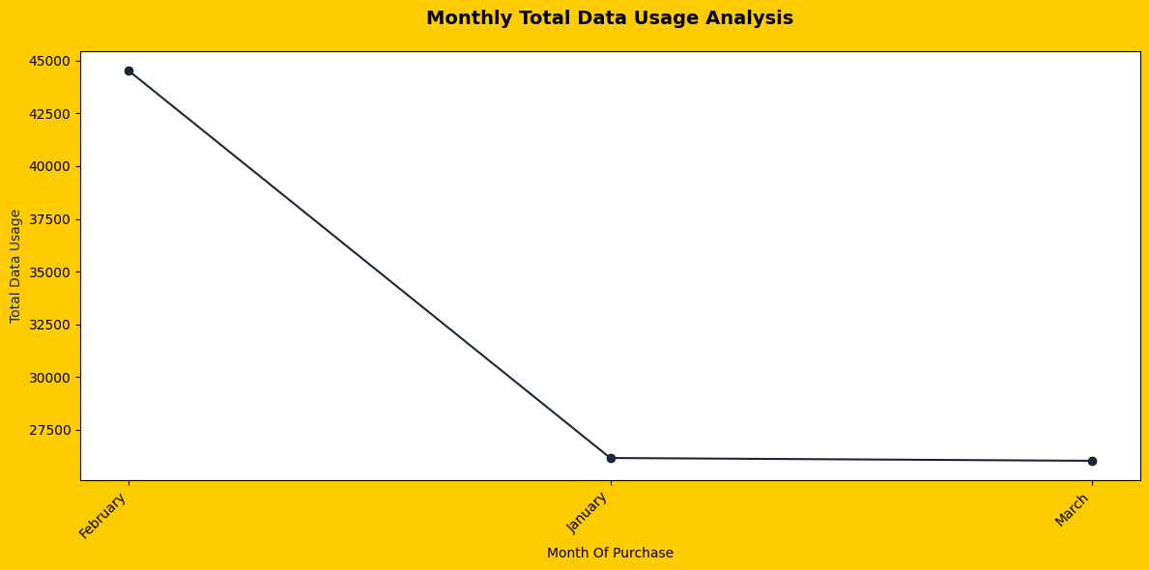
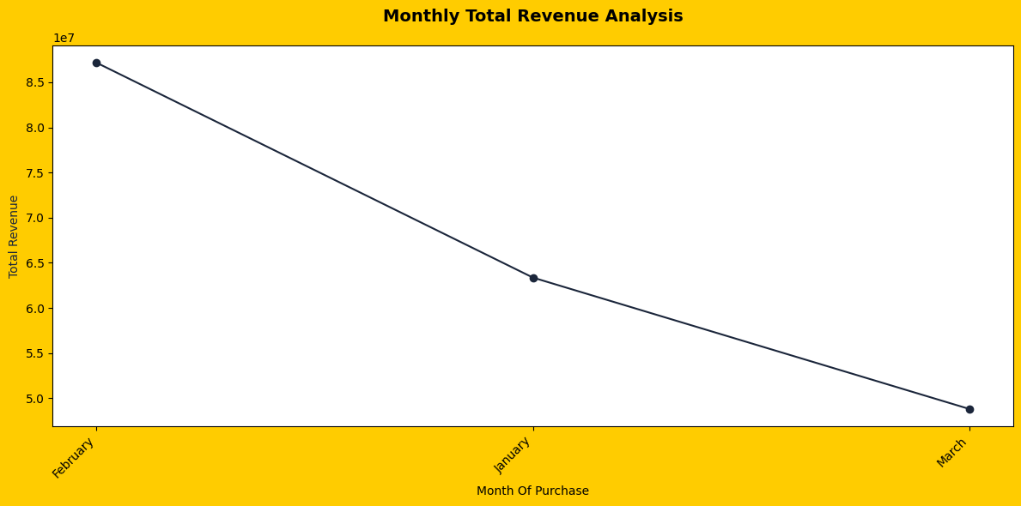
MONTHLY DATA USAGE
FEB-44,534
JAN-22,160
MARCH-26,027
MONTHLY REVENUE
FEB-87,173,550
JAN-63,366,500
MAR-48,808,150

Slide 9
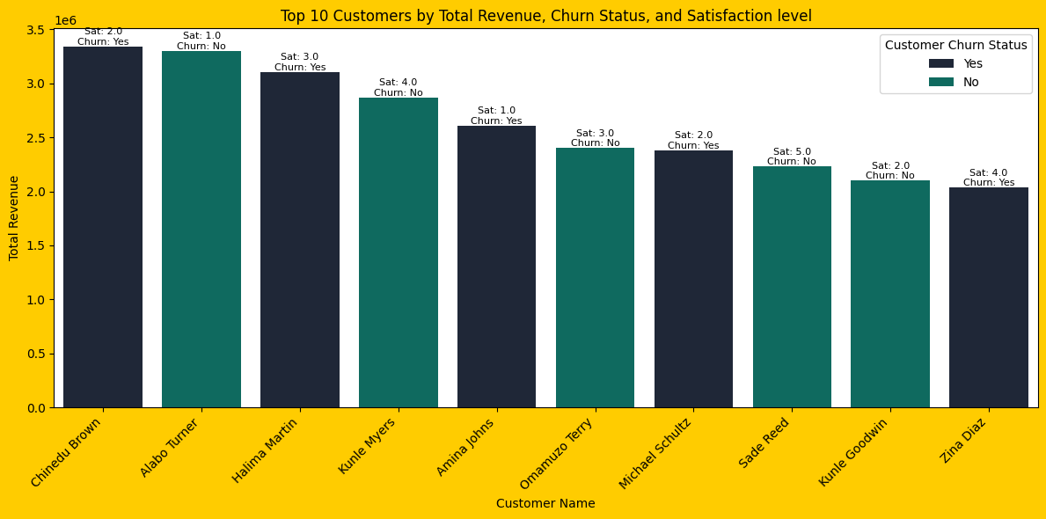
Top 10 Customers by Total Revenue (with Satisfaction rate & Churn Status)
3.34M
3.30M
3.10M
2.87M
2.60M
2.40M
2.38M
2.23M
2.10M
2.03M

Slide 10
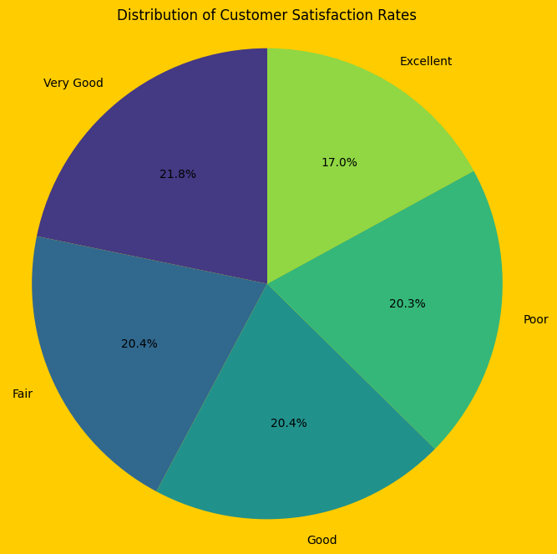
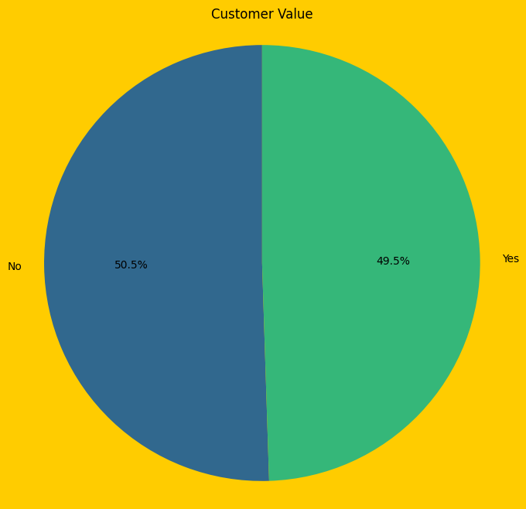
Distribution of Customer Satisfaction Rates
Customer Value

Slide 11
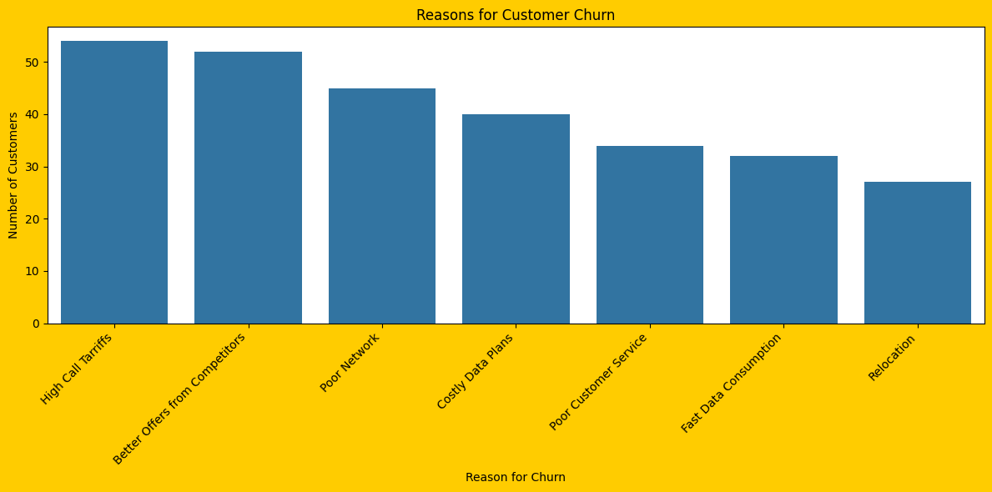
Reasons for Customer Churn

Slide 12
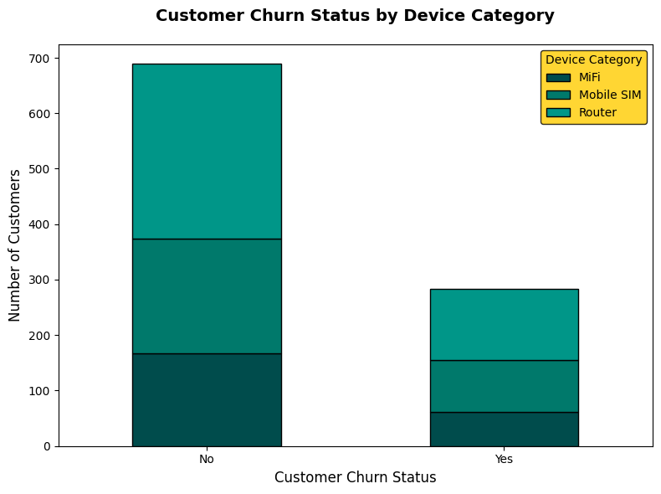
CUSTOMER CHURN STATUS BY DEVICE CATEGORY
316
207
129
94
167
61

Slide 13
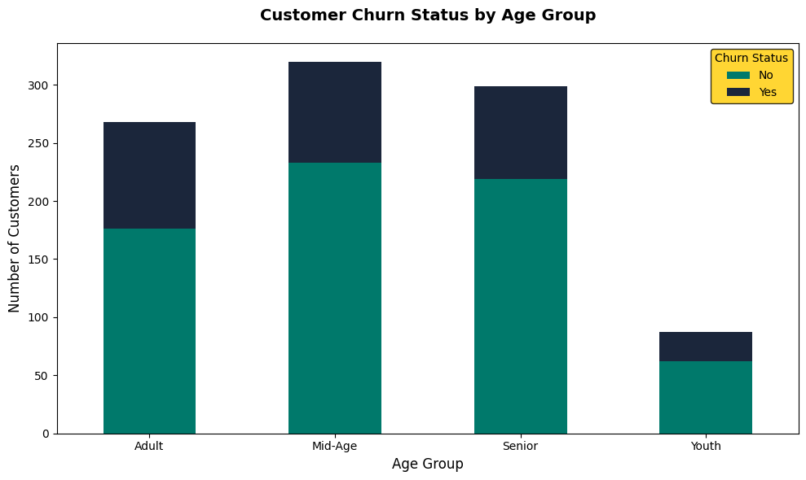
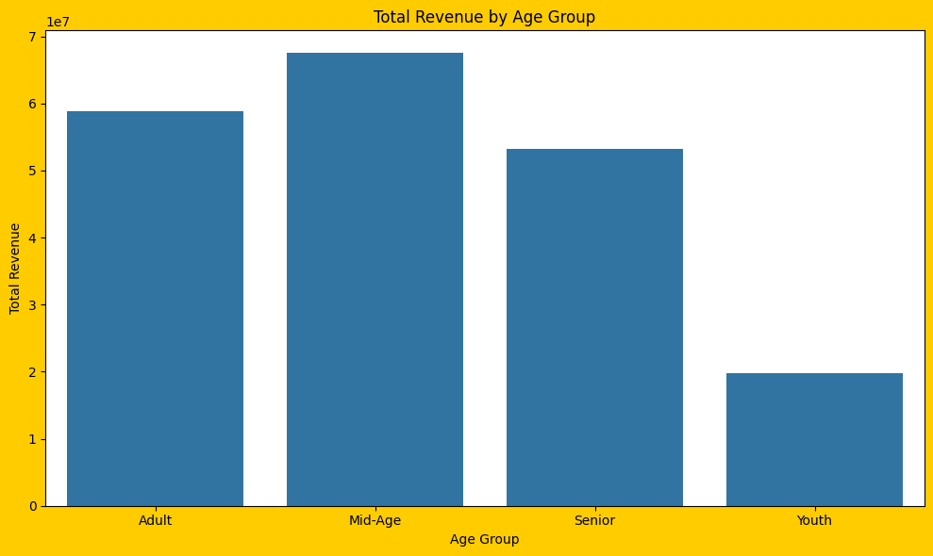
CUSTOMER CHURN STATUS BY AGE GROUP
TOTAL REVENUE BY AGE GROUP
87
80
92
25
58,811,200
67,514,000
53,253,500
19,769,500

Slide 14
CONCLUSION
RECOMMENDATIONS
Keep more customers by giving rewards, discounts, and special offers to loyal users.
Review prices and create flexible plans that meet the needs of young and active users.
Improve network quality and make customer service faster and more helpful.
Listen to customer feedback to fix common complaints and improve satisfaction. The next survey should include Ebonyi and Ogun State.
Track key numbers like revenue, churn rate, and customer growth every month to guide decisions.
MTN made good progress, earning ₦199.3 million from 496 customers.
Most customers (71%) are still active, but 29% have stopped using the service.
Monthly plans and Router/MiFi users bring in the most money and use the most data.
Young and middle-aged customers use MTN services more and spend more than older customers.
Some customers are unhappy about network issues, high prices, and slow customer service, which leads to churn.

Slide 15
THANK YOU

